Slide 1
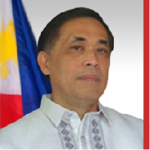
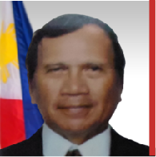
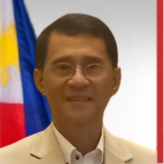
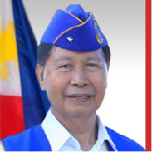
Board of Trustees
2 0 2 5 – 2 0 2 6
LEO ANGELO D. LEUTERIO
Chairman
• BS PMA 1988
• PhD units in PASA, Bicol University
• Masters in Management (Industrial Relations), UP
• Diploma in Results Based Management, AIM
• Vice Chairman, Holy Child College of Davao
JOSE C. LALISAN JR.
Vice Chairman & Corporate Auditor
• BS PMA 1971
• Director, Directorate for Personnel and Record Management, PNP
• Master in National Security Administration, NDCP
• Executive Security Consultant, EEI
• Past Director, Rotary Club of Davao
• Charter Member, Rotary Club of San Juan del Monte
BARTOLOME VICENTE O. BACARRO
President & Chairman Executive Committee
• BS PMA 1988
• Chief of Staff, AFP, 2022
• Medal of Valor Awardee
Commander, Southern Luzon Command
• Commander, 2nd Infantry Division
• Commandant of Cadets, PMA
• Commander, 502nd Infantry Brigade
SALVADOR Q. ESGUERRA
Vice President & Chairman, Nomination & Election Committee
• BS PMA 1974
• BS Electrical Engineering, UP Diliman
• Commander, AFP CEIS
• Master in Management
• Executive Director, AGFO
• Trustee, AGFO Foundation, Inc.
• Deputy Administrator, PVAO
• Vice President for Operations, VFP
• Cavaliers Award, Naval Operation, PMAAAI 1974

